Slide 1
Data In, Facts Out:
Automated Monitoring of Facts by FactWatcher
Chengkai Li
Associate Professor, Department of Computer Science and Engineering
Director, Innovative Database and Information Systems Research (IDIR) Laboratory
University of Texas at Arlington
Nanjing University, Oct. 12th, 2015
©2015 The University of Texas at Arlington. All Rights Reserved.

Slide 2
Our Computational Journalism Project
Started in 2010. Collaborative project with Duke, Google Research, HP Labs, Stanford, and Chinese Academy of Sciences
Story finding: finding and monitoring number-based facts pertinent to real-world events. The facts are leads to news stories.
FactWatcher
Fact checking: discovering and checking factual claims in political discourses, social media, and news.
ClaimBuster
©2015 The University of Texas at Arlington. All Rights Reserved.

Slide 3
FactWatcher
Automated Monitoring of Facts from Real-World Events
©2015 The University of Texas at Arlington. All Rights Reserved.

Slide 4
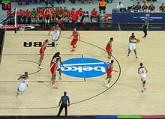
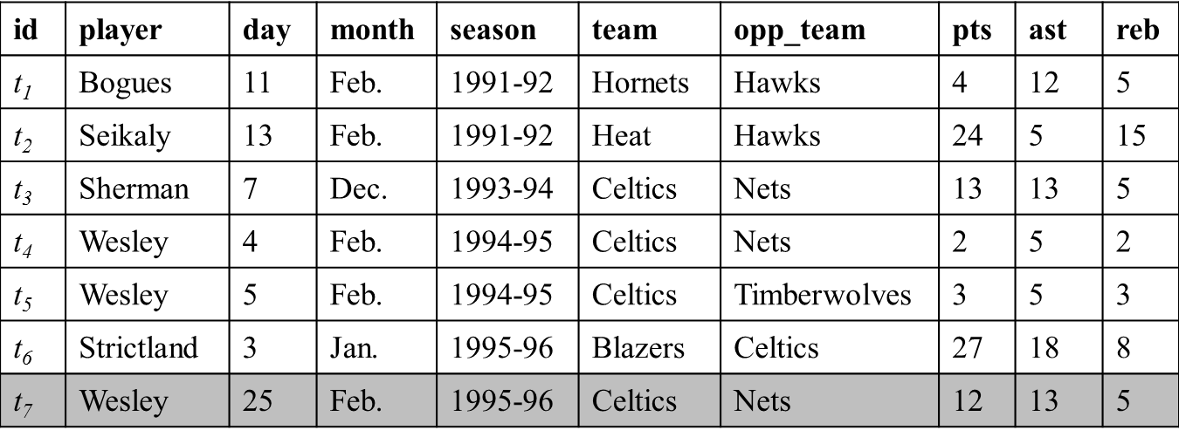
FactWatcher
Tuple t for new real world event appended to database
Constraint | Measure
month=Feb | pts, ast, reb
opp_team=Nets | ast, reb
team=Celtics & opp_team=Nets | ast, reb
… | …
Find constraint-measure pair (C, M) such that t is in the contextual skyline
Wesley had 12 points, 13 assists and 5 rebounds on February 25, 1996 to become the first player with a 12/13/5 (points/assists/rebounds) in February.
Generate factual claim
http://en.wikipedia.org/wiki/Basketball
©2015 The University of Texas at Arlington. All Rights Reserved.

Slide 5
Fact Finding
Prominent streaks
Long consecutive subsequence of high values in a sequence
One-of-the-few objects
Qualifying statements that can only be made for very few objects
Situational facts
Comparison contexts and spaces that make a given object stand out
©2015 The University of Texas at Arlington. All Rights Reserved.

Slide 6
FactWatcher Finds Three Types of Facts (and can be Extended)
Domains
sports, weather, crimes, transportation, finance, social media analytics
Examples from Real News Media
Prominent streaks
“This month the Chinese capital has experienced 10 days with a maximum temperature in around 35 degrees Celsius – the most for the month of July in a decade.” http://www.chinadaily.com.cn/china/2010-07/27/content_11055675.htm
“The Nikkei 225 closed below 10000 for the 12th consecutive week, the longest such streak since June 2009.”
http://www.bloomberg.com/news/articles/2010-08-06/japanese-stocks-fall-for-second-day-this-week-on-u-s-jobless-claims-yen
©2015 The University of Texas at Arlington. All Rights Reserved.

Slide 7
FactWatcher Finds Three Types of Facts (and can be Extended)
Examples from Real News Media
Situational facts, One-of-the-few objects
“Paul George had 21 points, 11 rebounds and 5 assists to become the first Pacers player with a 20/10/5 (points/rebounds/assists) game against the Bulls since Detlef Schrempf in December 1992.” http://espn.go.com/espn/elias?date=20130205
“The social world’s most viral photo ever generated 3.5 million likes, 170,000 comments and 460,000 shares by Wednesday afternoon.” http://www.cnbc.com/id/49728455
©2015 The University of Texas at Arlington. All Rights Reserved.

Slide 8
FactWatcher Demo
http://idir.uta.edu/factwatcher/
©2015 The University of Texas at Arlington. All Rights Reserved.

Slide 9
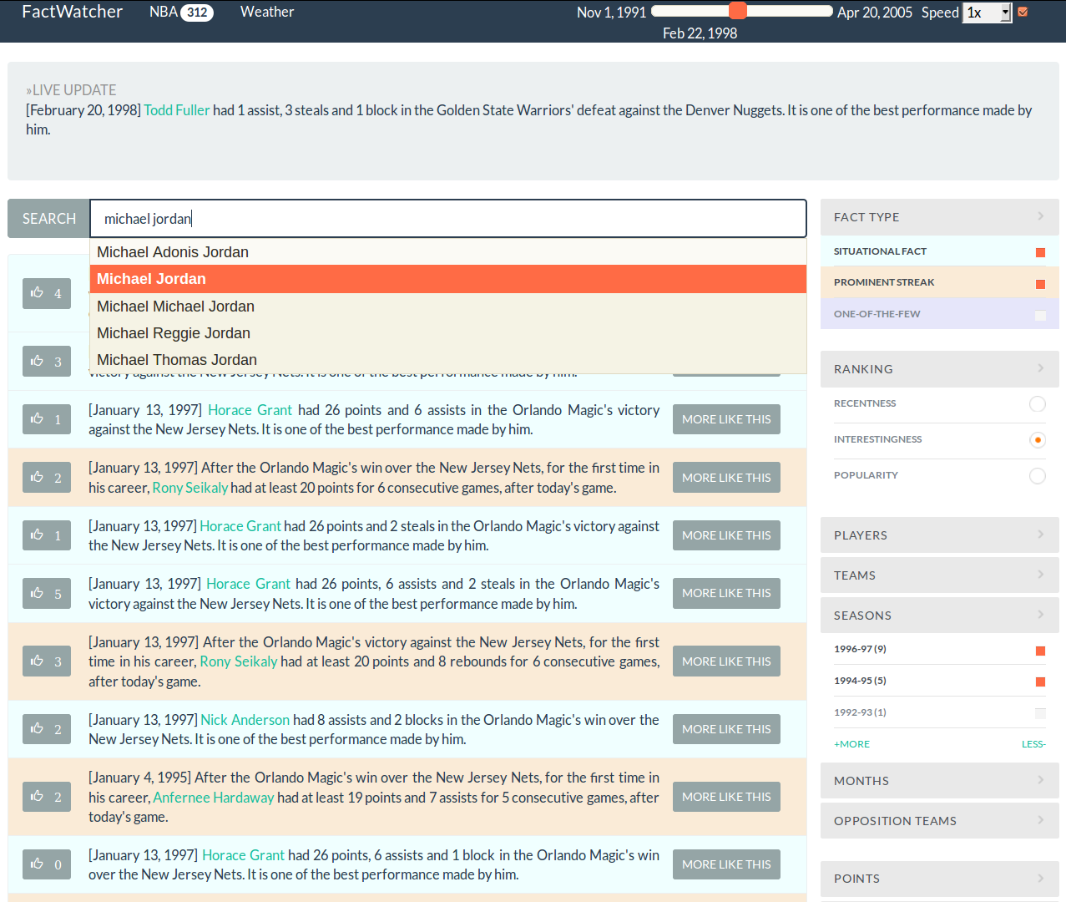


Presented In
Excellent Demo Award
http://idir.uta.edu/factwatcher/
©2015 The University of Texas at Arlington. All Rights Reserved.

Slide 10
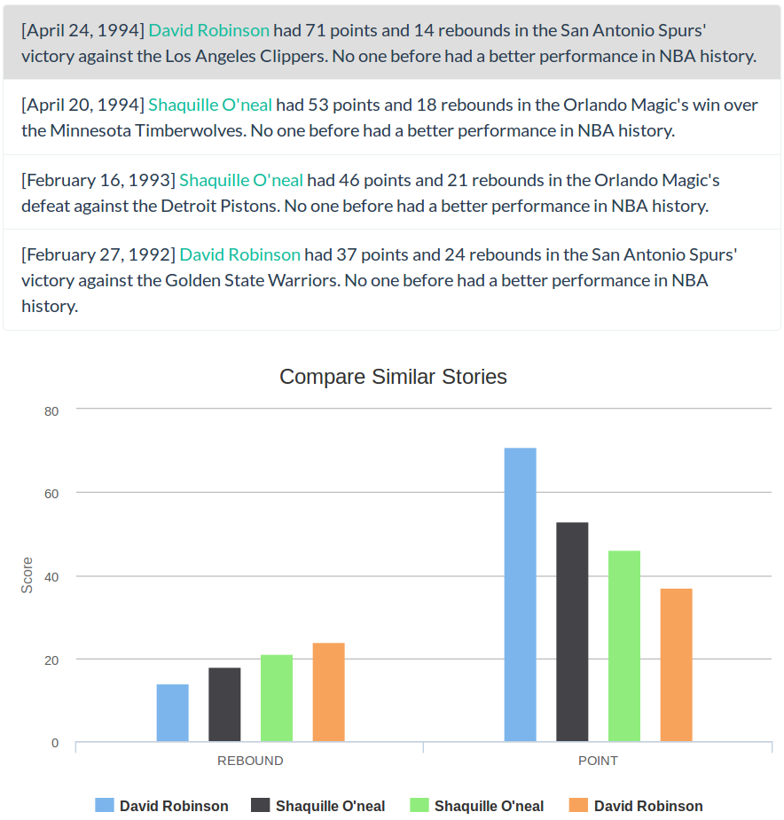
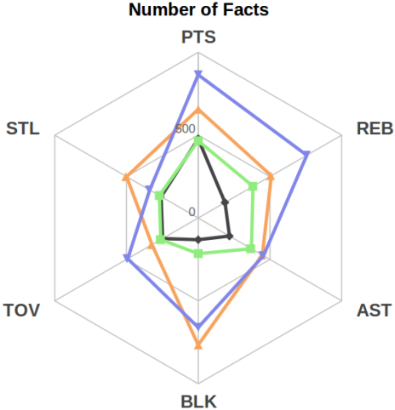
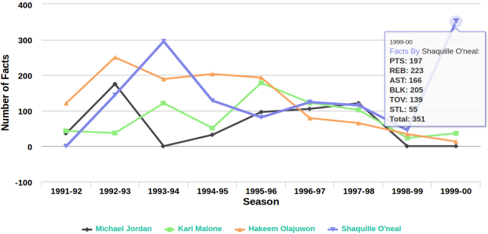
©2015 The University of Texas at Arlington. All Rights Reserved.

Slide 11
How were these Facts Discovered in Current Systems?
Our (educated?) guess
Experts monitor real-world events (e.g., watching an NBA game), have a gut-feeling, issue database queries, check out or not
Prepared facts-to-be (e.g., Nowitzki only needs 477 more points to surpass O'Neal. Perhaps will happen around Christmas 2015)
Predefined templates of facts/database queries
Perhaps in-house systems/algorithms similar to FactWatcher
©2015 The University of Texas at Arlington. All Rights Reserved.

Slide 12

Elias Sports Bureau
©2015 The University of Texas at Arlington. All Rights Reserved.

Slide 13
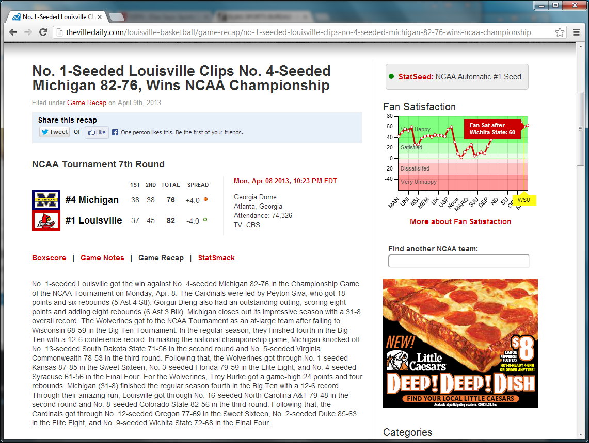
StatSheet
©2015 The University of Texas at Arlington. All Rights Reserved.

Slide 14

Narrative Science
©2015 The University of Texas at Arlington. All Rights Reserved.

Slide 15
Publications
Online Frequent Episode Mining. Xiang Ao, Ping Luo, Chengkai Li, Fuzhen Zhuang, and Qing He. ICDE 2015, pages 891-902.
Data In, Fact Out: Automated Monitoring of Facts by FactWatcher. Naeemul Hassan, Afroza Sultana, You Wu, Gensheng Zhang, Chengkai Li, Jun Yang, and Cong Yu. VLDB 2014, pages 1557-1560. Demonstration description. (excellent demonstration award)
Finding, Monitoring, and Checking Claims Computationally Based on Structured Data. Brett Walenz, You (Will) Wu, Seokhyun (Alex) Song, Emre Sonmez, Eric Wu, Kevin Wu, Pankaj K. Agarwal, Jun Yang, Naeemul Hassan, Afroza Sultana, Gensheng Zhang, Chengkai Li, Cong Yu. 2014 Computation+Journalism Symposium.
Incremental Discovery of Prominent Situational Facts. Afroza Sultana, Naeemul Hassan, Chengkai Li, Jun Yang, Cong Yu. ICDE 2014, pages 112-123.
Discovering General Prominent Streaks in Sequence Data. Gensheng Zhang, Xiao Jiang, Ping Luo, Min Wang, Chengkai Li. ACM TKDD, 8(2):article 9, June 2014.
Discovering and Learning Sensational Episodes of News Events. Xiang Ao, Ping Luo, Chengkai Li, Fuzhen Zhuang, Qing He, and Zhongzhi Shi. WWW 2014, pages 217-218.
On "One of the Few" Objects. You Wu, Pankaj K. Agarwal, Chengkai Li, Jun Yang, Cong Yu. KDD 2012, pages 1487-1495.
Prominent Streak Discovery in Sequence Data. Xiao Jiang, Chengkai Li, Ping Luo, Min Wang, Yong Yu. KDD 2011, pages 1280-1288.
©2015 The University of Texas at Arlington. All Rights Reserved.

Slide 16
Incremental Discovery of Prominent Situational Facts. Afroza Sultana, Naeemul Hassan, Chengkai Li, Jun Yang, Cong Yu. ICDE 2014, pages 112-123.
©2015 The University of Texas at Arlington. All Rights Reserved.

Slide 17
Situational Facts
“Paul George had 21 points, 11 rebounds and 5 assists to become the first Pacers player with a 20/10/5 (points/rebounds/assists) game against the Bulls since Detlef Schrempf in December 1992.”
(http://espn.go.com/espn/elias?date=20130205)
©2015 The University of Texas at Arlington. All Rights Reserved.

Slide 18


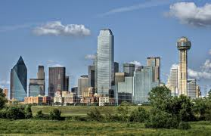
Skyline
www.rtkl.com
www.utepprintstore.com
jansport.com
©2015 The University of Texas at Arlington. All Rights Reserved.

Slide 19
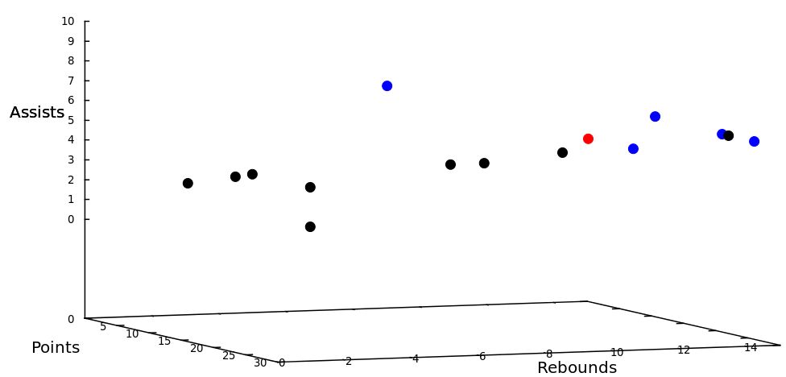
Situational Facts
“Paul George had 21 points, 11 rebounds and 5 assists to become the first Pacers player with a 20/10/5 (points/rebounds/assists) game against the Bulls since Detlef Schrempf in December 1992.”
(http://espn.go.com/espn/elias?date=20130205)
©2015 The University of Texas at Arlington. All Rights Reserved.

Slide 20
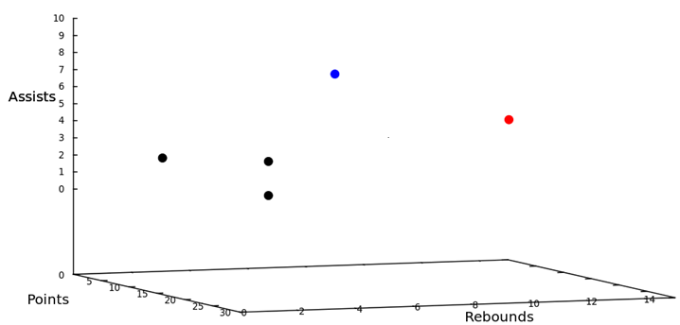
Situational Facts
“Paul George had 21 points, 11 rebounds and 5 assists to become the first Pacers player with a 20/10/5 (points/rebounds/assists) game against the Bulls since Detlef Schrempf in December 1992.”
(http://espn.go.com/espn/elias?date=20130205)
©2015 The University of Texas at Arlington. All Rights Reserved.

Slide 21
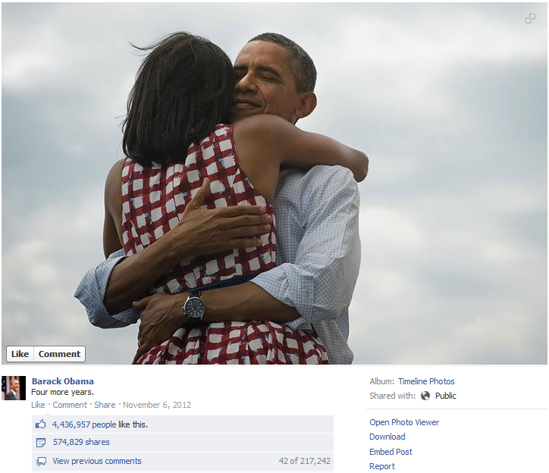
Situational Facts
“The social world’s most viral photo ever generated 3.5 million likes, 170,000 comments and 460,000 shares by Wednesday afternoon.”
(http://www.cnbc.com/id/49728455/President Obama Sets New Social Media Record)
©2015 The University of Texas at Arlington. All Rights Reserved.

Slide 22
Situational Facts
“The social world’s most viral photo ever generated 3.5 million likes, 170,000 comments and 460,000 shares by Wednesday afternoon.”
(http://www.cnbc.com/id/49728455/President Obama Sets New Social Media Record)
©2015 The University of Texas at Arlington. All Rights Reserved.

Slide 23
Situational Facts
“The social world’s most viral photo ever generated 3.5 million likes, 170,000 comments and 460,000 shares by Wednesday afternoon.”
(http://www.cnbc.com/id/49728455/President Obama Sets New Social Media Record)
©2015 The University of Texas at Arlington. All Rights Reserved.

Slide 24
Situational Facts
Stock Data: Stock A becomes the first stock in history with price over $300 and market cap over $400 billion.
Weather Data: Today’s measures of wind speed and humidity are x and y, respectively. City B has never encountered such high wind speed and humidity in March.
Criminal Records: There were 50 DUI arrests and 20 collisions in city C yesterday, the first time in 2013.
Financial Analyst
Journalists
Scientists
Citizens
©2015 The University of Texas at Arlington. All Rights Reserved.

Slide 25
A Mini-world of Basketball Gamelogs
id | player | day | month | season | team | opp_team | pts | ast | reb
t₁ | Bogues | 11 | Feb. | 1991-92 | Hornets | Hawks | 4 | 12 | 5
t₂ | Seikaly | 13 | Feb. | 1991-92 | Heat | Hawks | 24 | 5 | 15
t₃ | Sherman | 7 | Dec. | 1993-94 | Celtics | Nets | 13 | 13 | 5
t₄ | Wesley | 4 | Feb. | 1994-95 | Celtics | Nets | 2 | 5 | 2
t₅ | Wesley | 5 | Feb. | 1994-95 | Celtics | Timberwolves | 3 | 5 | 3
t₆ | Strictland | 3 | Jan. | 1995-96 | Blazers | Celtics | 27 | 18 | 8
t₇ | Wesley | 25 | Feb. | 1995-96 | Celtics | Nets | 12 | 13 | 5
Last tuple appended to table
©2015 The University of Texas at Arlington. All Rights Reserved.

Slide 26
A Mini-world of Basketball Gamelogs
id | player | day | month | season | team | opp_team | pts | ast | reb
t₁ | Bogues | 11 | Feb. | 1991-92 | Hornets | Hawks | 4 | 12 | 5
t₂ | Seikaly | 13 | Feb. | 1991-92 | Heat | Hawks | 24 | 5 | 15
t₃ | Sherman | 7 | Dec. | 1993-94 | Celtics | Nets | 13 | 13 | 5
t₄ | Wesley | 4 | Feb. | 1994-95 | Celtics | Nets | 2 | 5 | 2
t₅ | Wesley | 5 | Feb. | 1994-95 | Celtics | Timberwolves | 3 | 5 | 3
t₆ | Strictland | 3 | Jan. | 1995-96 | Blazers | Celtics | 27 | 18 | 8
t₇ | Wesley | 25 | Feb. | 1995-96 | Celtics | Nets | 12 | 13 | 5
©2015 The University of Texas at Arlington. All Rights Reserved.

Slide 27
A Mini-world of Basketball Gamelogs
id | player | day | month | season | team | opp_team | pts | ast | reb
t₁ | Bogues | 11 | Feb. | 1991-92 | Hornets | Hawks | 4 | 12 | 5
t₂ | Seikaly | 13 | Feb. | 1991-92 | Heat | Hawks | 24 | 5 | 15
t₃ | Sherman | 7 | Dec. | 1993-94 | Celtics | Nets | 13 | 13 | 5
t₄ | Wesley | 4 | Feb. | 1994-95 | Celtics | Nets | 2 | 5 | 2
t₅ | Wesley | 5 | Feb. | 1994-95 | Celtics | Timberwolves | 3 | 5 | 3
t₆ | Strictland | 3 | Jan. | 1995-96 | Blazers | Celtics | 27 | 18 | 8
t₇ | Wesley | 25 | Feb. | 1995-96 | Celtics | Nets | 12 | 13 | 5
©2015 The University of Texas at Arlington. All Rights Reserved.

Slide 28
A Mini-world of Basketball Gamelogs
id | player | day | month | season | team | opp_team | pts | ast | reb
t₁ | Bogues | 11 | Feb. | 1991-92 | Hornets | Hawks | 4 | 12 | 5
t₂ | Seikaly | 13 | Feb. | 1991-92 | Heat | Hawks | 24 | 5 | 15
t₃ | Sherman | 7 | Dec. | 1993-94 | Celtics | Nets | 13 | 13 | 5
t₄ | Wesley | 4 | Feb. | 1994-95 | Celtics | Nets | 2 | 5 | 2
t₅ | Wesley | 5 | Feb. | 1994-95 | Celtics | Timberwolves | 3 | 5 | 3
t₆ | Strictland | 3 | Jan. | 1995-96 | Blazers | Celtics | 27 | 18 | 8
t₇ | Wesley | 25 | Feb. | 1995-96 | Celtics | Nets | 12 | 13 | 5
Wesley had 12 points, 13 assists and 5 rebounds on February 25, 1996 to become the first player with a 12/13/5 (points/assists/rebounds) in February.
©2015 The University of Texas at Arlington. All Rights Reserved.

Slide 29
A Mini-world of Basketball Gamelogs
id | player | day | month | season | team | opp_team | pts | ast | reb
t₁ | Bogues | 11 | Feb. | 1991-92 | Hornets | Hawks | 4 | 12 | 5
t₂ | Seikaly | 13 | Feb. | 1991-92 | Heat | Hawks | 24 | 5 | 15
t₃ | Sherman | 7 | Dec. | 1993-94 | Celtics | Nets | 13 | 13 | 5
t₄ | Wesley | 4 | Feb. | 1994-95 | Celtics | Nets | 2 | 5 | 2
t₅ | Wesley | 5 | Feb. | 1994-95 | Celtics | Timberwolves | 3 | 5 | 3
t₆ | Strictland | 3 | Jan. | 1995-96 | Blazers | Celtics | 27 | 18 | 8
t₇ | Wesley | 25 | Feb. | 1995-96 | Celtics | Nets | 12 | 13 | 5
©2015 The University of Texas at Arlington. All Rights Reserved.

Slide 30
A Mini-world of Basketball Gamelogs
id | player | day | month | season | team | opp_team | pts | ast | reb
t₁ | Bogues | 11 | Feb. | 1991-92 | Hornets | Hawks | 4 | 12 | 5
t₂ | Seikaly | 13 | Feb. | 1991-92 | Heat | Hawks | 24 | 5 | 15
t₃ | Sherman | 7 | Dec. | 1993-94 | Celtics | Nets | 13 | 13 | 5
t₄ | Wesley | 4 | Feb. | 1994-95 | Celtics | Nets | 2 | 5 | 2
t₅ | Wesley | 5 | Feb. | 1994-95 | Celtics | Timberwolves | 3 | 5 | 3
t₆ | Strictland | 3 | Jan. | 1995-96 | Blazers | Celtics | 27 | 18 | 8
t₇ | Wesley | 25 | Feb. | 1995-96 | Celtics | Nets | 12 | 13 | 5
Wesley had 13 assists and 5 rebounds on February 25, 1996 to become the second Celtics player with a 13/5 (assists/rebounds) game against the Nets.
©2015 The University of Texas at Arlington. All Rights Reserved.

Slide 31
Problem Definition
Dimension space: D={d₁,… ,d_{n}}
Measure space: M ={m₁,… ,m_{s}}
id | player | day | month | season | team | opp_team | pts | ast | reb
t₁ | Bogues | 11 | Feb. | 1991-92 | Hornets | Hawks | 4 | 12 | 5
t₂ | Seikaly | 13 | Feb. | 1991-92 | Heat | Hawks | 24 | 5 | 15
t₃ | Sherman | 7 | Dec. | 1993-94 | Celtics | Nets | 13 | 13 | 5
t₄ | Wesley | 4 | Feb. | 1994-95 | Celtics | Nets | 2 | 5 | 2
t₅ | Wesley | 5 | Feb. | 1994-95 | Celtics | Timberwolves | 3 | 5 | 3
t₆ | Strictland | 3 | Jan. | 1995-96 | Blazers | Celtics | 27 | 18 | 8
append-only table
©2015 The University of Texas at Arlington. All Rights Reserved.

Slide 32
Problem Definition
Constraint (C): d₁=v₁∧d₂=v₂∧. . . ∧ d_{n}=v_{n}, v_{i}∈dom(d_{i})∪{∗}
team=Celtics ∧ opp_team=Nets
id | player | day | month | season | team | opp_team | pts | ast | rb
t₁ | Bogues | 11 | Feb. | 1991-92 | Hornets | Hawks | 4 | 12 | 5
t₂ | Seikaly | 13 | Feb. | 1991-92 | Heat | Hawks | 24 | 5 | 15
t₃ | Sherman | 7 | Dec. | 1993-94 | Celtics | Nets | 13 | 13 | 5
t₄ | Wesley | 4 | Feb. | 1994-95 | Celtics | Nets | 2 | 5 | 2
t₅ | Wesley | 5 | Feb. | 1994-95 | Celtics | Timberwolves | 3 | 5 | 3
t₆ | Strictland | 3 | Jan. | 1995-96 | Blazers | Celtics | 27 | 18 | 8
©2015 The University of Texas at Arlington. All Rights Reserved.

Slide 33
Problem Definition
Constraint-Measure Pair (C, M): Combination of a constraint and measure subspace
(team=Celtics ∧ opp_team=Nets,{assists,rebounds})
id | player | day | month | season | team | opp_team | pts | ast | reb
t₁ | Bogues | 11 | Feb. | 1991-92 | Hornets | Hawks | 4 | 12 | 5
t₂ | Seikaly | 13 | Feb. | 1991-92 | Heat | Hawks | 24 | 5 | 15
t₃ | Sherman | 7 | Dec. | 1993-94 | Celtics | Nets | 13 | 13 | 5
t₄ | Wesley | 4 | Feb. | 1994-95 | Celtics | Nets | 2 | 5 | 2
t₅ | Wesley | 5 | Feb. | 1994-95 | Celtics | Timberwolves | 3 | 5 | 3
t₆ | Strictland | 3 | Jan. | 1995-96 | Blazers | Celtics | 27 | 18 | 8
©2015 The University of Texas at Arlington. All Rights Reserved.

Slide 34
Problem Definition
Contextual skyline: skyline regarding (C, M)
σ_{team=Celtics ∧ opp_team=Nets}(R), M={assists,rebounds}
{t₃}
id | player | day | month | season | team | opp_team | pts | ast | reb
t₁ | Bogues | 11 | Feb. | 1991-92 | Hornets | Hawks | 4 | 12 | 5
t₂ | Seikaly | 13 | Feb. | 1991-92 | Heat | Hawks | 24 | 5 | 15
t₃ | Sherman | 7 | Dec. | 1993-94 | Celtics | Nets | 13 | 13 | 5
t₄ | Wesley | 4 | Feb. | 1994-95 | Celtics | Nets | 2 | 5 | 2
t₅ | Wesley | 5 | Feb. | 1994-95 | Celtics | Timberwolves | 3 | 5 | 3
t₆ | Strictland | 3 | Jan. | 1995-96 | Blazers | Celtics | 27 | 18 | 8
©2015 The University of Texas at Arlington. All Rights Reserved.

Slide 35
FactWatcher
Tuple t for new real world event appended to database
Constraint | Measure
month=Feb | pts, ast, reb
opp_team=Nets | ast, reb
team=Celtics & opp_team=Nets | ast, reb
… | …
Find constraint-measure pair (C, M) such that t is in the contextual skyline
Wesley had 12 points, 13 assists and 5 rebounds on February 25, 1996 to become the first player with a 12/13/5 (points/assists/rebounds) in February.
Generate factual claim
http://en.wikipedia.org/wiki/Basketball
©2015 The University of Texas at Arlington. All Rights Reserved.

Slide 36
Related Work
Conventional skyline analysis (Borzsonyi et al. ICDE 2001)
Q: context, measure subspace A: contextual skyline tuples
Our focus--- A: tuple Q: constraint-measure pairs
©2015 The University of Texas at Arlington. All Rights Reserved.

Slide 37
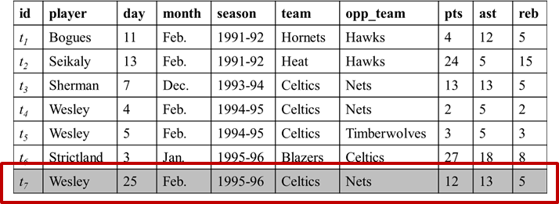
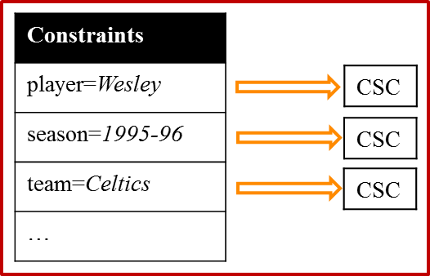
Related Works
Compressed Skycube (Xia et al. SIGMOD 2006)
Update compressed skycube in monitoring fashion
We adapted CSC for each constraint: Constraint-CSC
Constraint | Measure
month=Feb | pts, ast, reb
opp_team=Nets | ast, reb
team=Celtics & opp_team=Nets | ast, reb
… | …
Query
©2015 The University of Texas at Arlington. All Rights Reserved.

Slide 38
Related Works
Prominent Analysis by Ranking (Wu et. Al. VLDB 2009)
Static data, onetime query
We dealt on continuous data, standing query
Find the contexts where an object is ranked high in a single scoring attribute
We considered skyline on multiple measure subspaces
©2015 The University of Texas at Arlington. All Rights Reserved.

Slide 39
Modeling
Τ
{t₁,t₂,t₃,t₄,t₅}
id | d₁ | d₂ | d₃ | m₁ | m₂
t₁ | a₁ | b₂ | c₂ | 10 | 15
t₂ | a₁ | b₁ | c₁ | 15 | 10
t₃ | a₂ | b₁ | c₂ | 17 | 17
t₄ | a₂ | b₁ | c₁ | 20 | 20
t₅ | a₁ | b₁ | c₁ | 11 | 15
a₁
{t₁,t₂,t₅}
b₁
{t₂,t₃,t₄,t₅}
c₁
{t₂,t₄,t₅}
a₁,b₁
{t₂,t₅}
a₁,c₁
{t₂,t₅}
b₁,c₁
{t₂,t₄,t₅}
a₁,b₁,c₁
{t₂,t₅}
d₁=a₁ ∧ d₂=b₁ ∧ d₃=c₁
Lattice of C ^{t5}
Tuple Satisfied Constraint C ^{t} : If ∀d_{i}∈D, C.d_{i}=∗ or C.d_{i}=t.d_{i}, t satisfies C.
©2015 The University of Texas at Arlington. All Rights Reserved.

Slide 40
Modeling
Lattice of C ^{t4}
Τ
id | d₁ | d₂ | d₃ | m₁ | m₂
t₁ | a₁ | b₂ | c₂ | 10 | 15
t₂ | a₁ | b₁ | c₁ | 15 | 10
t₃ | a₂ | b₁ | c₂ | 17 | 17
t₄ | a₂ | b₁ | c₁ | 20 | 20
t₅ | a₁ | b₁ | c₁ | 11 | 15
a₁
a₂
b₁
c₁
a₁,b₁
a₂,b₁
a₁,c₁
a₂,c₁
b₁,c₁
a₁,b₁,c₁
a₂,b₁,c₁
Lattice of C ^{t5}
©2015 The University of Texas at Arlington. All Rights Reserved.

Slide 41
Modeling
Lattice of C ^{t4}
Τ
id | d₁ | d₂ | d₃ | m₁ | m₂
t₁ | a₁ | b₂ | c₂ | 10 | 15
t₂ | a₁ | b₁ | c₁ | 15 | 10
t₃ | a₂ | b₁ | c₂ | 17 | 17
t₄ | a₂ | b₁ | c₁ | 20 | 20
t₅ | a₁ | b₁ | c₁ | 11 | 15
a₁
a₂
b₁
c₁
a₁,b₁
a₂,b₁
a₁,c₁
a₂,c₁
b₁,c₁
a₁,b₁,c₁
a₂,b₁,c₁
Lattice of C ^{t5}
Lattice Intersection: C ^{t4,t5}=C ^{t4}∩C ^{t5}
©2015 The University of Texas at Arlington. All Rights Reserved.

Slide 42
Brute-Force Approach
Τ
id | d₁ | d₂ | d₃ | m₁ | m₂
t₁ | a₁ | b₂ | c₂ | 10 | 15
t₂ | a₁ | b₁ | c₁ | 15 | 10
t₃ | a₂ | b₁ | c₂ | 17 | 17
t₄ | a₂ | b₁ | c₁ | 20 | 20
t₅ | a₁ | b₁ | c₁ | 11 | 15
a₁
b₁
c₁
a₁,b₁
a₁,c₁
b₁,c₁
a₁,b₁,c₁
©2015 The University of Texas at Arlington. All Rights Reserved.

Slide 43
Brute-Force Approach
Τ
id | d₁ | d₂ | d₃ | m₁ | m₂
t₁ | a₁ | b₂ | c₂ | 10 | 15
t₂ | a₁ | b₁ | c₁ | 15 | 10
t₃ | a₂ | b₁ | c₂ | 17 | 17
t₄ | a₂ | b₁ | c₁ | 20 | 20
t₅ | a₁ | b₁ | c₁ | 11 | 15
a₁
b₁
c₁
a₁,b₁
a₁,c₁
b₁,c₁
a₁,b₁,c₁
©2015 The University of Texas at Arlington. All Rights Reserved.

Slide 44
Brute-Force Approach
Τ
id | d₁ | d₂ | d₃ | m₁ | m₂
t₁ | a₁ | b₂ | c₂ | 10 | 15
t₂ | a₁ | b₁ | c₁ | 15 | 10
t₃ | a₂ | b₁ | c₂ | 17 | 17
t₄ | a₂ | b₁ | c₁ | 20 | 20
t₅ | a₁ | b₁ | c₁ | 11 | 15
a₁
b₁
c₁
a₁,b₁
a₁,c₁
b₁,c₁
a₁,b₁,c₁
©2015 The University of Texas at Arlington. All Rights Reserved.

Slide 45
Brute-Force Approach
Τ
id | d₁ | d₂ | d₃ | m₁ | m₂
t₁ | a₁ | b₂ | c₂ | 10 | 15
t₂ | a₁ | b₁ | c₁ | 15 | 10
t₃ | a₂ | b₁ | c₂ | 17 | 17
t₄ | a₂ | b₁ | c₁ | 20 | 20
t₅ | a₁ | b₁ | c₁ | 11 | 15
a₁
b₁
c₁
a₁,b₁
a₁,c₁
b₁,c₁
a₁,b₁,c₁
©2015 The University of Texas at Arlington. All Rights Reserved.

Slide 46
Brute-Force Approach
Τ
id | d₁ | d₂ | d₃ | m₁ | m₂
t₁ | a₁ | b₂ | c₂ | 10 | 15
t₂ | a₁ | b₁ | c₁ | 15 | 10
t₃ | a₂ | b₁ | c₂ | 17 | 17
t₄ | a₂ | b₁ | c₁ | 20 | 20
t₅ | a₁ | b₁ | c₁ | 11 | 15
a₁
b₁
c₁
a₁,b₁
a₁,c₁
b₁,c₁
a₁,b₁,c₁
©2015 The University of Texas at Arlington. All Rights Reserved.

Slide 47
Brute-Force Approach
Τ
id | d₁ | d₂ | d₃ | m₁ | m₂
t₁ | a₁ | b₂ | c₂ | 10 | 15
t₂ | a₁ | b₁ | c₁ | 15 | 10
t₃ | a₂ | b₁ | c₂ | 17 | 17
t₄ | a₂ | b₁ | c₁ | 20 | 20
t₅ | a₁ | b₁ | c₁ | 11 | 15
a₁
b₁
c₁
a₁,b₁
a₁,c₁
b₁,c₁
a₁,b₁,c₁
©2015 The University of Texas at Arlington. All Rights Reserved.

Slide 48
Brute-Force Approach
Τ
id | d₁ | d₂ | d₃ | m₁ | m₂
t₁ | a₁ | b₂ | c₂ | 10 | 15
t₂ | a₁ | b₁ | c₁ | 15 | 10
t₃ | a₂ | b₁ | c₂ | 17 | 17
t₄ | a₂ | b₁ | c₁ | 20 | 20
t₅ | a₁ | b₁ | c₁ | 11 | 15
a₁
b₁
c₁
a₁,b₁
a₁,c₁
b₁,c₁
a₁,b₁,c₁
Total |R|*(2^{|D|+|M|}-1) comparisons!
Total 16 comparisons in this case!
©2015 The University of Texas at Arlington. All Rights Reserved.

Slide 49
Challenges
Exhaustive comparison with every tuple
Under every constraint
Over every measure subspace
©2015 The University of Texas at Arlington. All Rights Reserved.

Slide 50
Challenges and Ideas
Exhaustive comparison with every tuple
Tuple reduction
Comparison with skyline tuples is enough
t₄≻_{{m1,m2}}t₃≻_{{m1,m2}}t₅ => t₄≻_{{m1,m2}}t₅
id | d₁ | d₂ | d₃ | m₁ | m₂
t₁ | a₁ | b₂ | c₂ | 10 | 15
t₂ | a₁ | b₁ | c₁ | 15 | 10
t₃ | a₂ | b₁ | c₂ | 17 | 17
t₄ | a₂ | b₁ | c₁ | 20 | 20
t₅ | a₁ | b₁ | c₁ | 11 | 15
©2015 The University of Texas at Arlington. All Rights Reserved.

Slide 51
Challenges and Ideas
Under every constraint
Constraint pruning
In C ^{t,t'}, one comparison on t and t' is enough
Τ
id | d₁ | d₂ | d₃ | m₁ | m₂
t₁ | a₁ | b₂ | c₂ | 10 | 15
t₂ | a₁ | b₁ | c₁ | 15 | 10
t₃ | a₂ | b₁ | c₂ | 17 | 17
t₄ | a₂ | b₁ | c₁ | 20 | 20
t₅ | a₁ | b₁ | c₁ | 11 | 15
a₁
b₁
c₁
a₁,b₁
a₁,c₁
b₁,c₁
a₁,b₁,c₁
©2015 The University of Texas at Arlington. All Rights Reserved.

Slide 52
Challenges and Ideas
Under every constraint
Constraint pruning
In C ^{t,t'}, one comparison on t and t' is enough
Τ
id | d₁ | d₂ | d₃ | m₁ | m₂
t₁ | a₁ | b₂ | c₂ | 10 | 15
t₂ | a₁ | b₁ | c₁ | 15 | 10
t₃ | a₂ | b₁ | c₂ | 17 | 17
t₄ | a₂ | b₁ | c₁ | 20 | 20
t₅ | a₁ | b₁ | c₁ | 11 | 15
a₁
b₁
c₁
a₁,b₁
a₁,c₁
b₁,c₁
a₁,b₁,c₁
©2015 The University of Texas at Arlington. All Rights Reserved.

Slide 53
Challenges and Ideas
Over every measure subspace
Sharing computation across measure subspaces
Reusing computations on full space in subspaces
Τ
id | d₁ | d₂ | d₃ | m₁ | m₂
t₁ | a₁ | b₂ | c₂ | 10 | 15
t₂ | a₁ | b₁ | c₁ | 15 | 10
t₃ | a₂ | b₁ | c₂ | 17 | 17
t₄ | a₂ | b₁ | c₁ | 20 | 20
t₅ | a₁ | b₁ | c₁ | 11 | 15
a₁
b₁
c₁
a₁,b₁
a₁,c₁
b₁,c₁
a₁,b₁,c₁
©2015 The University of Texas at Arlington. All Rights Reserved.

Slide 54
Challenges and Ideas
Over every measure subspace
Sharing computation across measure subspaces
Reusing computations on full space in subspaces
Τ
id | d₁ | d₂ | d₃ | m₁ | m₂
t₁ | a₁ | b₂ | c₂ | 10 | 15
t₂ | a₁ | b₁ | c₁ | 15 | 10
t₃ | a₂ | b₁ | c₂ | 17 | 17
t₄ | a₂ | b₁ | c₁ | 20 | 20
t₅ | a₁ | b₁ | c₁ | 11 | 15
a₁
b₁
c₁
a₁,b₁
a₁,c₁
b₁,c₁
a₁,b₁,c₁
©2015 The University of Texas at Arlington. All Rights Reserved.

Slide 55
Our Algorithms
Tuple reduction + Constraint pruning
BottomUp
TopDown
Tuple reduction + Constraint pruning + Sharing computation
SBottomUp
STopDown
©2015 The University of Texas at Arlington. All Rights Reserved.

Slide 56
BottomUp
Stores a tuple for every such constraint that qualifies it as a contextual skyline tuple
Traverses the constraints in C ^{t} in a bottom-up, breadth-first manner
©2015 The University of Texas at Arlington. All Rights Reserved.

Slide 57
BottomUp
id | d₁ | d₂ | d₃ | m₁ | m₂
t₁ | a₁ | b₂ | c₂ | 10 | 15
t₂ | a₁ | b₁ | c₁ | 15 | 10
t₃ | a₂ | b₁ | c₂ | 17 | 17
t₄ | a₂ | b₁ | c₁ | 20 | 20
t₅ | a₁ | b₁ | c₁ | 11 | 15
Τ
{t₄}
a₁
{t₁,t₂}
b₁
{t₄}
c₁
{t₄}
a₁,b₁
{t₂}
a₁,c₁
{t₂}
b₁,c₁
{t₄}
a₁,b₁,c₁
{t₂}
©2015 The University of Texas at Arlington. All Rights Reserved.

Slide 58
BottomUp
id | d₁ | d₂ | d₃ | m₁ | m₂
t₁ | a₁ | b₂ | c₂ | 10 | 15
t₂ | a₁ | b₁ | c₁ | 15 | 10
t₃ | a₂ | b₁ | c₂ | 17 | 17
t₄ | a₂ | b₁ | c₁ | 20 | 20
t₅ | a₁ | b₁ | c₁ | 11 | 15
Τ
{t₄}
a₁
{t₁,t₂}
b₁
{t₄}
c₁
{t₄}
a₁,b₁
{t₂}
a₁,c₁
{t₂}
b₁,c₁
{t₄}
a₁,b₁,c₁
{t₂}
©2015 The University of Texas at Arlington. All Rights Reserved.

Slide 59
BottomUp
id | d₁ | d₂ | d₃ | m₁ | m₂
t₁ | a₁ | b₂ | c₂ | 10 | 15
t₂ | a₁ | b₁ | c₁ | 15 | 10
t₃ | a₂ | b₁ | c₂ | 17 | 17
t₄ | a₂ | b₁ | c₁ | 20 | 20
t₅ | a₁ | b₁ | c₁ | 11 | 15
Τ
{t₄}
a₁
{t₁,t₂}
b₁
{t₄}
c₁
{t₄}
a₁,b₁
{t₂}
a₁,c₁
{t₂}
b₁,c₁
{t₄}
a₁,b₁,c₁
{t_{2,}t₅}
©2015 The University of Texas at Arlington. All Rights Reserved.

Slide 60
BottomUp
id | d₁ | d₂ | d₃ | m₁ | m₂
t₁ | a₁ | b₂ | c₂ | 10 | 15
t₂ | a₁ | b₁ | c₁ | 15 | 10
t₃ | a₂ | b₁ | c₂ | 17 | 17
t₄ | a₂ | b₁ | c₁ | 20 | 20
t₅ | a₁ | b₁ | c₁ | 11 | 15
Τ
{t₄}
a₁
{t₁,t₂}
b₁
{t₄}
c₁
{t₄}
a₁,b₁
{t₂}
a₁,c₁
{t₂}
b₁,c₁
{t₄}
a₁,b₁,c₁
{t_{2,}t₅}
©2015 The University of Texas at Arlington. All Rights Reserved.

Slide 61
BottomUp
id | d₁ | d₂ | d₃ | m₁ | m₂
t₁ | a₁ | b₂ | c₂ | 10 | 15
t₂ | a₁ | b₁ | c₁ | 15 | 10
t₃ | a₂ | b₁ | c₂ | 17 | 17
t₄ | a₂ | b₁ | c₁ | 20 | 20
t₅ | a₁ | b₁ | c₁ | 11 | 15
Τ
{t₄}
a₁
{t₁,t₂}
b₁
{t₄}
c₁
{t₄}
a₁,b₁
{t_{2,}t₅}
a₁,c₁
{t_{2,}t₅}
b₁,c₁
{t₄}
a₁,b₁,c₁
{t_{2,}t₅}
©2015 The University of Texas at Arlington. All Rights Reserved.

Slide 62
BottomUp
id | d₁ | d₂ | d₃ | m₁ | m₂
t₁ | a₁ | b₂ | c₂ | 10 | 15
t₂ | a₁ | b₁ | c₁ | 15 | 10
t₃ | a₂ | b₁ | c₂ | 17 | 17
t₄ | a₂ | b₁ | c₁ | 20 | 20
t₅ | a₁ | b₁ | c₁ | 11 | 15
Τ
{t₄}
a₁
{t₁,t₂}
b₁
{t₄}
c₁
{t₄}
a₁,b₁
{t_{2,}t₅}
a₁,c₁
{t_{2,}t₅}
b₁,c₁
{t₄}
a₁,b₁,c₁
{t_{2,}t₅}
©2015 The University of Texas at Arlington. All Rights Reserved.

Slide 63
BottomUp
id | d₁ | d₂ | d₃ | m₁ | m₂
t₁ | a₁ | b₂ | c₂ | 10 | 15
t₂ | a₁ | b₁ | c₁ | 15 | 10
t₃ | a₂ | b₁ | c₂ | 17 | 17
t₄ | a₂ | b₁ | c₁ | 20 | 20
t₅ | a₁ | b₁ | c₁ | 11 | 15
Τ
{t₄}
a₁
{t₁,t₂}
b₁
{t₄}
c₁
{t₄}
a₁,b₁
{t_{2,}t₅}
a₁,c₁
{t_{2,}t₅}
b₁,c₁
{t₄}
a₁,b₁,c₁
{t_{2,}t₅}
©2015 The University of Texas at Arlington. All Rights Reserved.

Slide 64
BottomUp
id | d₁ | d₂ | d₃ | m₁ | m₂
t₁ | a₁ | b₂ | c₂ | 10 | 15
t₂ | a₁ | b₁ | c₁ | 15 | 10
t₃ | a₂ | b₁ | c₂ | 17 | 17
t₄ | a₂ | b₁ | c₁ | 20 | 20
t₅ | a₁ | b₁ | c₁ | 11 | 15
Τ
{t₄}
a₁
{t₁,t₂}
b₁
{t₄}
c₁
{t₄}
a₁,b₁
{t_{2,}t₅}
a₁,c₁
{t_{2,}t₅}
b₁,c₁
{t₄}
a₁,b₁,c₁
{t_{2,}t₅}
©2015 The University of Texas at Arlington. All Rights Reserved.

Slide 65
BottomUp
id | d₁ | d₂ | d₃ | m₁ | m₂
t₁ | a₁ | b₂ | c₂ | 10 | 15
t₂ | a₁ | b₁ | c₁ | 15 | 10
t₃ | a₂ | b₁ | c₂ | 17 | 17
t₄ | a₂ | b₁ | c₁ | 20 | 20
t₅ | a₁ | b₁ | c₁ | 11 | 15
Τ
{t₄}
a₁
{t₂,t₅}
b₁
{t₄}
c₁
{t₄}
a₁,b₁
{t_{2,}t₅}
a₁,c₁
{t_{2,}t₅}
b₁,c₁
{t₄}
6 comparisons in this case
a₁,b₁,c₁
{t_{2,}t₅}
©2015 The University of Texas at Arlington. All Rights Reserved.

Slide 66
BottomUp
Cons of BottomUp
Repetitive storage: space complexity
Repetitive comparisons: time complexity
TopDown stores a tuple for its maximal skyline constraints only.
©2015 The University of Texas at Arlington. All Rights Reserved.

Slide 67
TopDown
Skyline Constraints
Constraints whose contextual skylines include t.
Τ
{t₄}
a₁
{t₂,t₅}
b₁
{t₄}
c₁
{t₄}
id | d₁ | d₂ | d₃ | m₁ | m₂
t₁ | a₁ | b₂ | c₂ | 10 | 15
t₂ | a₁ | b₁ | c₁ | 15 | 10
t₃ | a₂ | b₁ | c₂ | 17 | 17
t₄ | a₂ | b₁ | c₁ | 20 | 20
t₅ | a₁ | b₁ | c₁ | 11 | 15
a₁,b₁
{t_{2,}t₅}
a₁,c₁
{t_{2,}t₅}
b₁,c₁
{t₄}
a₁,b₁,c₁
{t_{2,}t₅}
©2015 The University of Texas at Arlington. All Rights Reserved.

Slide 68
TopDown
Maximal Skyline Constraints
Constraints not subsumed by any other skyline constraints of t.
Τ
{t₄}
a₁
{t₂,t₅}
b₁
{t₄}
c₁
{t₄}
id | d₁ | d₂ | d₃ | m₁ | m₂
t₁ | a₁ | b₂ | c₂ | 10 | 15
t₂ | a₁ | b₁ | c₁ | 15 | 10
t₃ | a₂ | b₁ | c₂ | 17 | 17
t₄ | a₂ | b₁ | c₁ | 20 | 20
t₅ | a₁ | b₁ | c₁ | 11 | 15
a₁,b₁
{t_{2,}t₅}
a₁,c₁
{t_{2,}t₅}
b₁,c₁
{t₄}
a₁,b₁,c₁
{t_{2,}t₅}
©2015 The University of Texas at Arlington. All Rights Reserved.

Slide 69
TopDown
Maximal Skyline Constraints
Constraints not subsumed by any other skyline constraints of t.
Τ
{t₄}
a₁
{t₂,t₅}
b₁
{}
c₁
{}
id | d₁ | d₂ | d₃ | m₁ | m₂
t₁ | a₁ | b₂ | c₂ | 10 | 15
t₂ | a₁ | b₁ | c₁ | 15 | 10
t₃ | a₂ | b₁ | c₂ | 17 | 17
t₄ | a₂ | b₁ | c₁ | 20 | 20
t₅ | a₁ | b₁ | c₁ | 11 | 15
a₁,b₁
{}
a₁,c₁
{}
b₁,c₁
{}
a₁,b₁,c₁
{}
©2015 The University of Texas at Arlington. All Rights Reserved.

Slide 70
TopDown
id | d₁ | d₂ | d₃ | m₁ | m₂
t₁ | a₁ | b₂ | c₂ | 10 | 15
t₂ | a₁ | b₁ | c₁ | 15 | 10
t₃ | a₂ | b₁ | c₂ | 17 | 17
t₄ | a₂ | b₁ | c₁ | 20 | 20
t₅ | a₁ | b₁ | c₁ | 11 | 15
Τ
{t₄}
a₁
{t₁,t₂}
b₁
{}
c₁
{}
a₁,b₁
{}
a₁,c₁
{}
b₁,c₁
{}
a₁,b₁,c₁
{}
©2015 The University of Texas at Arlington. All Rights Reserved.

Slide 71
TopDown
id | d₁ | d₂ | d₃ | m₁ | m₂
t₁ | a₁ | b₂ | c₂ | 10 | 15
t₂ | a₁ | b₁ | c₁ | 15 | 10
t₃ | a₂ | b₁ | c₂ | 17 | 17
t₄ | a₂ | b₁ | c₁ | 20 | 20
t₅ | a₁ | b₁ | c₁ | 11 | 15
Τ
{t₄}
a₁
{t₁,t₂}
b₁
{}
c₁
{}
a₁,b₁
{}
a₁,c₁
{}
b₁,c₁
{}
a₁,b₁,c₁
{}
©2015 The University of Texas at Arlington. All Rights Reserved.

Slide 72
TopDown
id | d₁ | d₂ | d₃ | m₁ | m₂
t₁ | a₁ | b₂ | c₂ | 10 | 15
t₂ | a₁ | b₁ | c₁ | 15 | 10
t₃ | a₂ | b₁ | c₂ | 17 | 17
t₄ | a₂ | b₁ | c₁ | 20 | 20
t₅ | a₁ | b₁ | c₁ | 11 | 15
Τ
{t₄}
a₁
{t₁,t₂}
b₁
{}
c₁
{}
a₁,b₁
{}
a₁,c₁
{}
b₁,c₁
{}
a₁,b₁,c₁
{}
©2015 The University of Texas at Arlington. All Rights Reserved.

Slide 73
TopDown
id | d₁ | d₂ | d₃ | m₁ | m₂
t₁ | a₁ | b₂ | c₂ | 10 | 15
t₂ | a₁ | b₁ | c₁ | 15 | 10
t₃ | a₂ | b₁ | c₂ | 17 | 17
t₄ | a₂ | b₁ | c₁ | 20 | 20
t₅ | a₁ | b₁ | c₁ | 11 | 15
Τ
{t₄}
a₁
{t₁,t₂}
b₁
{}
c₁
{}
a₁,b₁
{}
a₁,c₁
{}
b₁,c₁
{}
a₁,b₁,c₁
{}
©2015 The University of Texas at Arlington. All Rights Reserved.

Slide 74
TopDown
id | d₁ | d₂ | d₃ | m₁ | m₂
t₁ | a₁ | b₂ | c₂ | 10 | 15
t₂ | a₁ | b₁ | c₁ | 15 | 10
t₃ | a₂ | b₁ | c₂ | 17 | 17
t₄ | a₂ | b₁ | c₁ | 20 | 20
t₅ | a₁ | b₁ | c₁ | 11 | 15
Τ
{t₄}
a₁
b₂
{t₁}
b₁
{}
c₂
{t₃}
c₁
{}
{
t₂}
,
t₁
a₁,b₁
{}
a₁,b₂
{}
a₁,c₁
{}
a₁,c₂
{}
b₁,c₁
{}
a₁,b₁,c₁
{}
©2015 The University of Texas at Arlington. All Rights Reserved.

Slide 75
TopDown
id | d₁ | d₂ | d₃ | m₁ | m₂
t₁ | a₁ | b₂ | c₂ | 10 | 15
t₂ | a₁ | b₁ | c₁ | 15 | 10
t₃ | a₂ | b₁ | c₂ | 17 | 17
t₄ | a₂ | b₁ | c₁ | 20 | 20
t₅ | a₁ | b₁ | c₁ | 11 | 15
Τ
{t₄}
a₁
{t₂,t₅}
b₂
{t₁}
b₁
{}
c₂
{t₃}
c₁
{}
a₁,b₁
{}
a₁,b₂
{}
a₁,c₁
{}
a₁,c₂
{t₁}
b₁,c₁
{}
a₁,b₁,c₁
{}
3 comparisons in this case
©2015 The University of Texas at Arlington. All Rights Reserved.

Slide 76
STopDown and SBottomUp
Con of BottomUp and TopDown
Need to compute over every measure subspace separately
STopDown and SBottomUp share computation across different subspaces
©2015 The University of Texas at Arlington. All Rights Reserved.

Slide 77
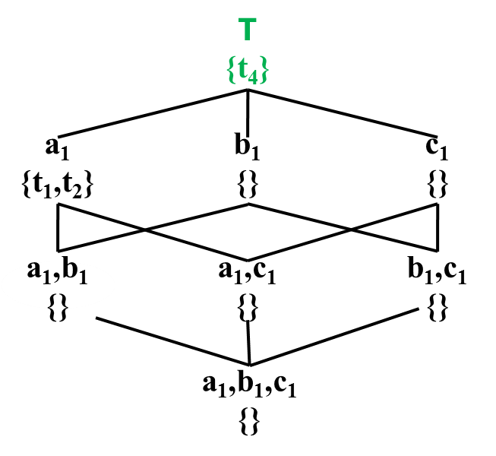
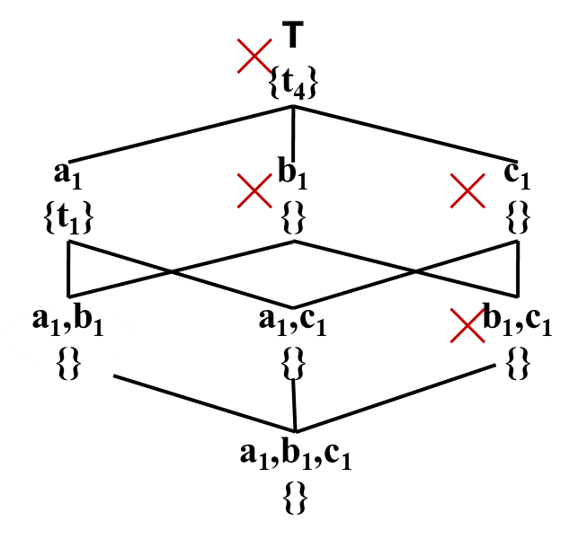
STopDown
id | d₁ | d₂ | d₃ | m₁ | m₂
t₁ | a₁ | b₂ | c₂ | 10 | 15
t₂ | a₁ | b₁ | c₁ | 15 | 10
t₃ | a₂ | b₁ | c₂ | 17 | 17
t₄ | a₂ | b₁ | c₁ | 20 | 20
t₅ | a₁ | b₁ | c₁ | 11 | 15
Comparison with t₄ is skipped
id | d₁ | d₂ | d₃ | m₁ | m₂
t₁ | a₁ | b₂ | c₂ | 10 | 15
t₂ | a₁ | b₁ | c₁ | 15 | 10
t₃ | a₂ | b₁ | c₂ | 17 | 17
t₄ | a₂ | b₁ | c₁ | 20 | 20
t₅ | a₁ | b₁ | c₁ | 11 | 15
©2015 The University of Texas at Arlington. All Rights Reserved.

Slide 78
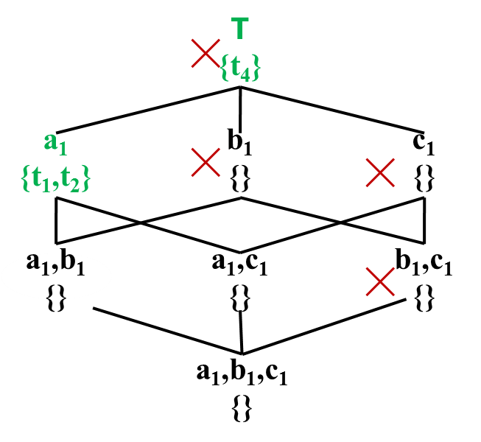
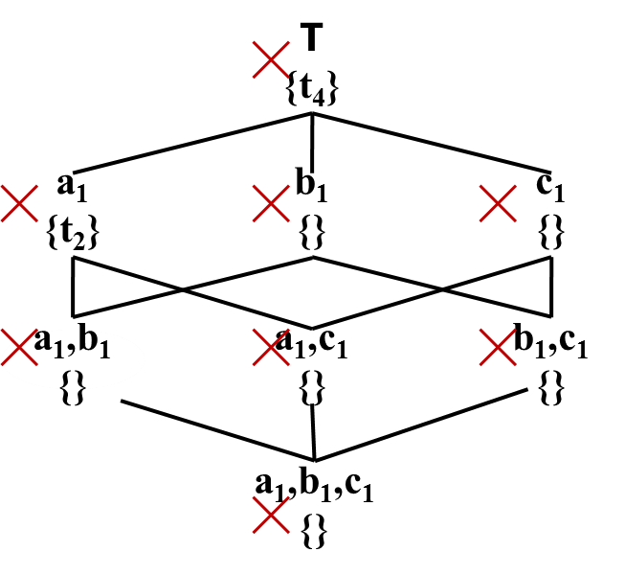
STopDown
id | d₁ | d₂ | d₃ | m₁ | m₂
t₁ | a₁ | b₂ | c₂ | 10 | 15
t₂ | a₁ | b₁ | c₁ | 15 | 10
t₃ | a₂ | b₁ | c₂ | 17 | 17
t₄ | a₂ | b₁ | c₁ | 20 | 20
t₅ | a₁ | b₁ | c₁ | 11 | 15
Comparisons with t₂ & t₄ are skipped
id | d₁ | d₂ | d₃ | m₁ | m₂
t₁ | a₁ | b₂ | c₂ | 10 | 15
t₂ | a₁ | b₁ | c₁ | 15 | 10
t₃ | a₂ | b₁ | c₂ | 17 | 17
t₄ | a₂ | b₁ | c₁ | 20 | 20
t₅ | a₁ | b₁ | c₁ | 11 | 15
©2015 The University of Texas at Arlington. All Rights Reserved.

Slide 79
Experiment Setup
NBA Dataset
317,371 tuples of NBA box scores from 1991-2004 seasons
8 dimension attributes
7 measure attributes
Weather Dataset
7.8 million tuples of weather forecast from different locations of six countries & regions of UK
7 dimension attributes
7 measure attributes
©2015 The University of Texas at Arlington. All Rights Reserved.

Slide 80
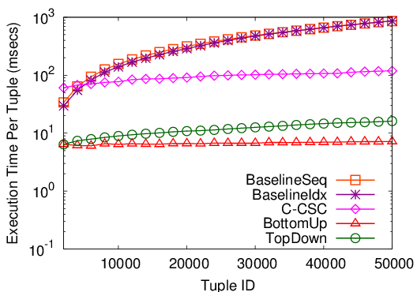
Memory-Based Implementation
NBA Dataset
Maintaining CSC for each constraint causes overhead
(Xia et al. SIGMOD 2006)
Can’t take advantage of constraint pruning
©2015 The University of Texas at Arlington. All Rights Reserved.

Slide 81
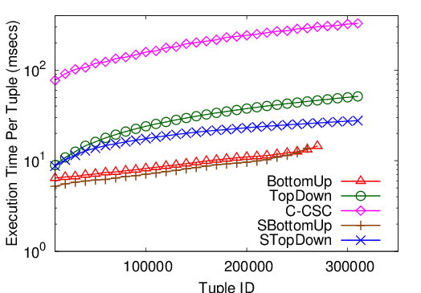
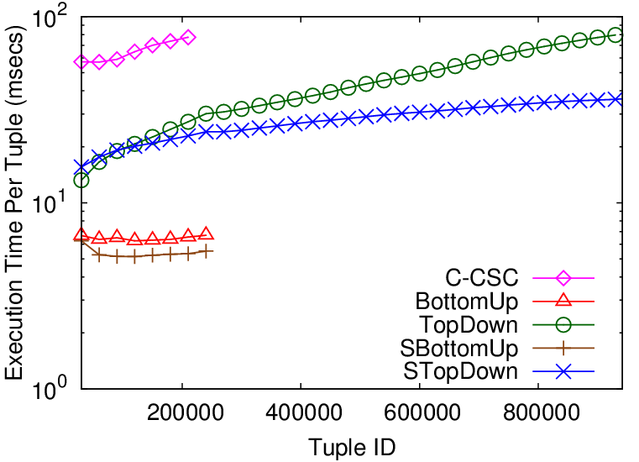
Memory-Based Implementation
NBA Dataset
Weather Dataset
BottomUp/SBottomUp exhausted available JVM heap
memory overflow
TopDown / STopDown was outperformed by BottomUp/ SBottomUp
Updating maximal skyline constraints causes overhead
©2015 The University of Texas at Arlington. All Rights Reserved.

Slide 82
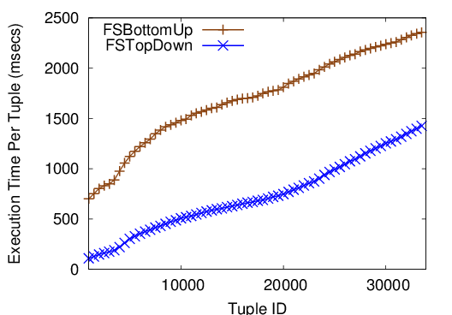
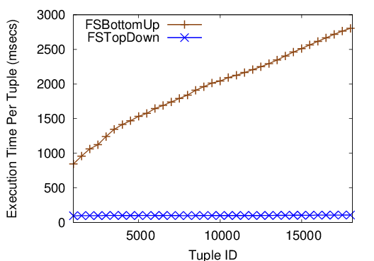
File-Based Implementation
NBA Dataset
Weather Dataset
Each (C,M) is stored in a binary file
While traversing, file-read operation occurs if file is non-empty: FSTopDown encounters many empty files
For updating, file-write operation occurs: FSTopDown stores fewer tuples
I/O-cost dominates in-memory computation
©2015 The University of Texas at Arlington. All Rights Reserved.

Slide 83
Discovered Facts
Lamar Odom had 30 points, 19 rebounds and 11 assists on March 6, 2004. No one before had a better or equal performance in NBA history.
Allen Iverson had 38 points and 16 assists on April 14, 2004 to become the first player with a 38/16 (points/assists) game in the 2004-2005 season.
Damon Stoudamire scored 54 points on January 14, 2005. It is the highest score in history made by any Trail Blazers.
©2015 The University of Texas at Arlington. All Rights Reserved.

Slide 84
Prominent Streak Discovery in Sequence Data. Xiao Jiang, Chengkai Li, Ping Luo, Min Wang, Yong Yu. KDD 2011, pages 1280-1288.
Discovering General Prominent Streaks in Sequence Data. Gensheng Zhang, Xiao Jiang, Ping Luo, Min Wang, Chengkai Li. ACM TKDD, 8(2):article 9, June 2014.
©2015 The University of Texas at Arlington. All Rights Reserved.

Slide 85
Prominent Streaks
Prominent streaks stated in news articles:
“This month the Chinese capital has experienced 10 days with a maximum temperature in around 35 degrees Celsius – the most for the month of July in a decade.”
“The Nikkei 225 closed below 10000 for the 12th consecutive week, the longest such streak since June 2009.”
“He (LeBron James) scored 35 or more points in nine consecutive games and joined Michael Jordan and Kobe Bryant as the only players since 1970 to accomplish the feat.”
©2015 The University of Texas at Arlington. All Rights Reserved.

Slide 86
Concepts
Streak
Input: a sequence of values
Streak <[l, r], v> is a triple: left-end ( l ), right-end ( r ), minimum value in interval [l,r]
3 1 7 7 2 5 4 6 7 3
<[6, 8], 4>
Streak dominance relation
s1=<[l1, r1], v1> dominates s2=<[l2, r2], v2> iff
r1 - l1 > r2 - l2, v1 >= v2 or r1 - l1 >= r2 - l2, v1 >v2
Prominent streaks (PS)
A streak is prominent if it is not dominated by any other streaks.
©2015 The University of Texas at Arlington. All Rights Reserved.

Slide 87
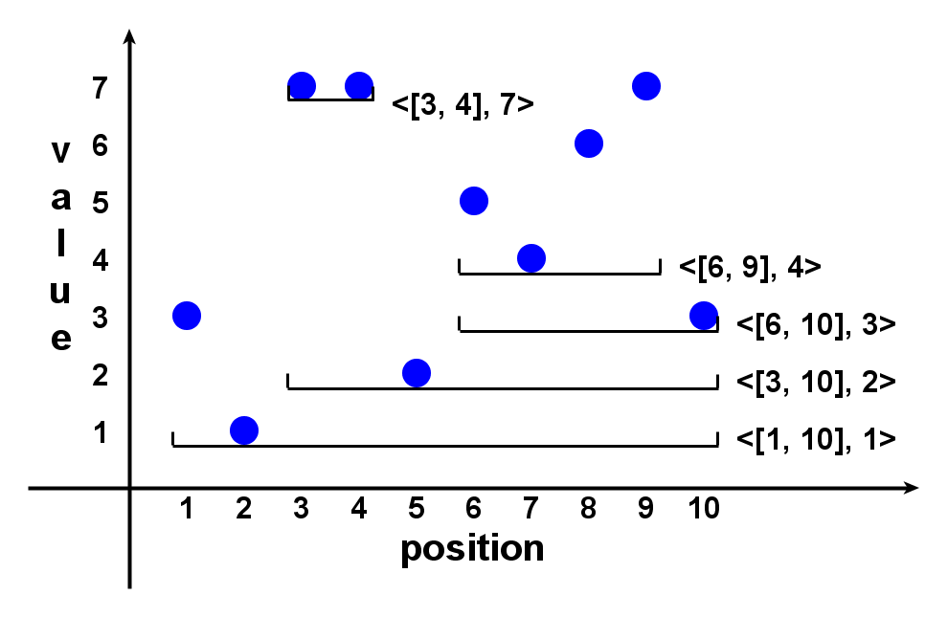
Example
3 1 7 7 2 5 4 6 7 3
©2015 The University of Texas at Arlington. All Rights Reserved.

Slide 88
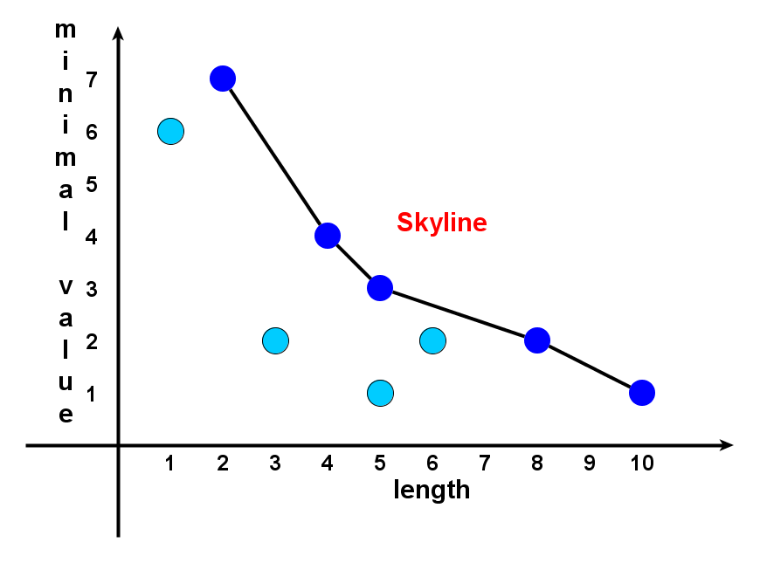
Prominent Streaks are Skyline Points in 2-d Space
3 1 7 7 2 5 4 6 7 3
©2015 The University of Texas at Arlington. All Rights Reserved.

Slide 89
Tasks
Task 1: discovery
Find all prominent streaks in a sequence
Task 2: monitoring
Always keep prominent streaks up-to-date, when sequence grows (real-world sequences often grow)
©2015 The University of Texas at Arlington. All Rights Reserved.

Slide 90
Solution Framework
Data Value Sequence
3 1 7 7 2 5 4 6 7 3
Candidate Generation Algorithms (brute-force, NLPS, LLPS)
Candidate Streaks
Skyline Operation [Börzsönyi et al. 2001]
(many algorithms)
Prominent Streaks
©2015 The University of Texas at Arlington. All Rights Reserved.

Slide 91
Candidate Generation: Number Of Candidates
Brute-force
Quadratic
NLPS
Superlinear
LLPS
Linear
©2015 The University of Texas at Arlington. All Rights Reserved.

Slide 92
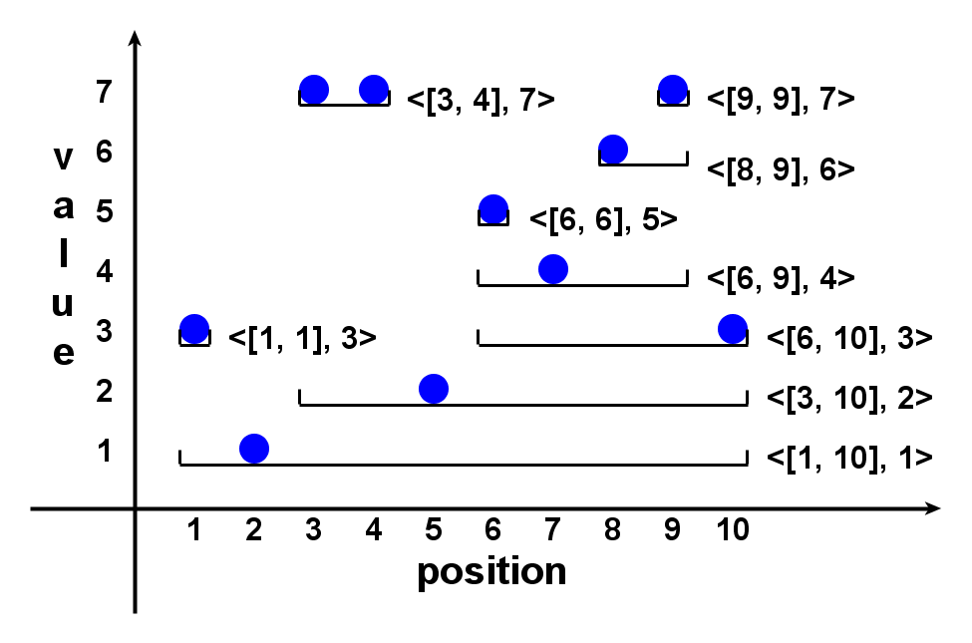
Local Prominent Streak
Local dominance relation
s1=<[l1, r1], v1> locally dominates s2=<[l2, r2], v2> iff
s1 dominates s2 and [l1, r1] ⊃ [l2, r2]
Local prominent streak (LPS)
A streak is locally prominent if it is not locally dominated by any other streaks.
©2015 The University of Texas at Arlington. All Rights Reserved.

Slide 93
Important Properties
(1) LPS is sufficient
A prominent streak must be an LPS.
(2) LPS is small
The number of LPSs is less than or equal to the sequence length.
(Hint: The number of LPSs getting min value at position k is at most 1.)
Conclusion
LPS is an excellent set of candidate streaks, of linear size.
Candidate generation problem => finding local prominent streaks
©2015 The University of Texas at Arlington. All Rights Reserved.

Slide 94
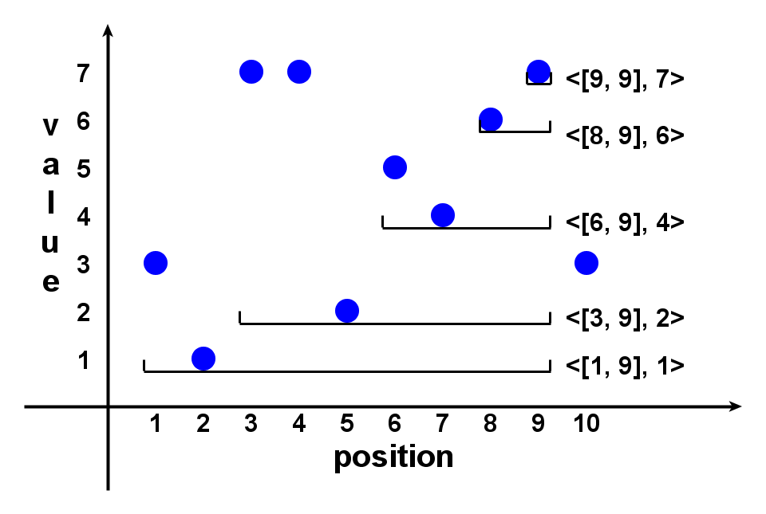
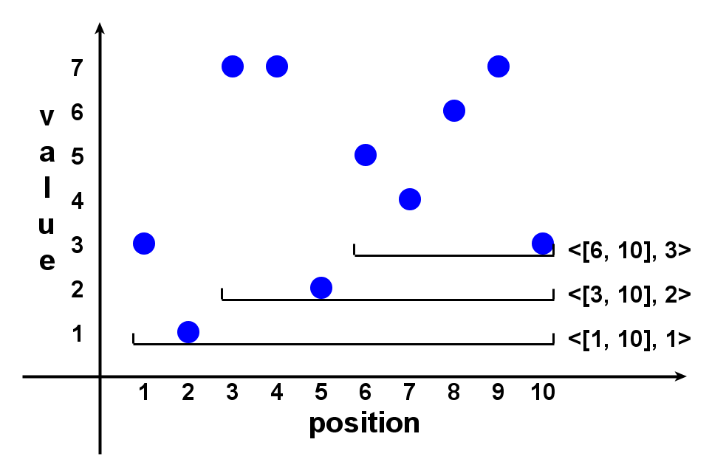
Linear LPS (LLPS) Method
Sequence p₁, p₂, …, p_{n}.
1. Maintain a list of candidate streaks when scanning the sequence rightward.
2. After p_{k} , right-ends of candidates are all k.
3. At p_{k+1} , try to extend the candidates rightward.
Candidates s:
(3.a) s.v < p_{k+1} : extend.
(3.b) s.v > p_{k+1} : belong to LPS.
(3.c) s.v >= p_{k+1} : extend the leftmost (longest) such s.
4. After p_{n} all remaining candidates are LPS.
©2015 The University of Texas at Arlington. All Rights Reserved.

Slide 95
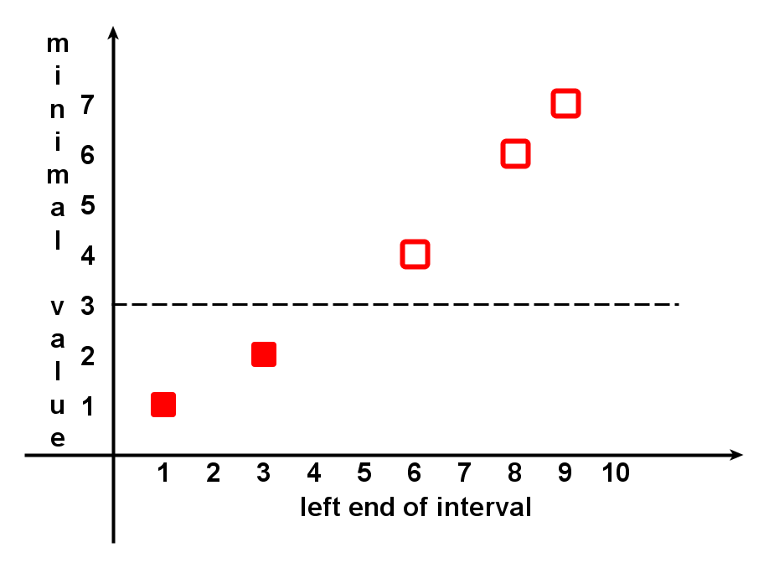
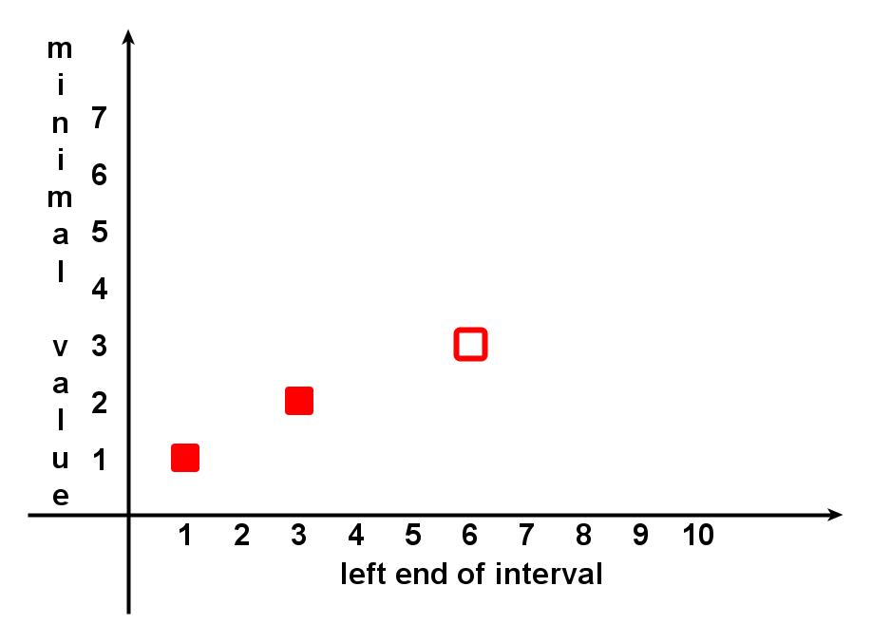
Linear LPS (LLPS) Method
Candidates share the same right-end, their minimum values monotonically increase, if they are listed in the increasing order of left-ends.
©2015 The University of Texas at Arlington. All Rights Reserved.

Slide 96
Linear LPS (LLPS) Method
After p_{k} , it has found:
All LPSs ending before k
Candidates ending at k either are LPSs or can be grown to LPSs ending after k.
Monitoring (keeping prominent streaks up-to-date) is simple:
If PSs till k are requested, compare all found LPSs and all remaining candidates.
©2015 The University of Texas at Arlington. All Rights Reserved.

Slide 97
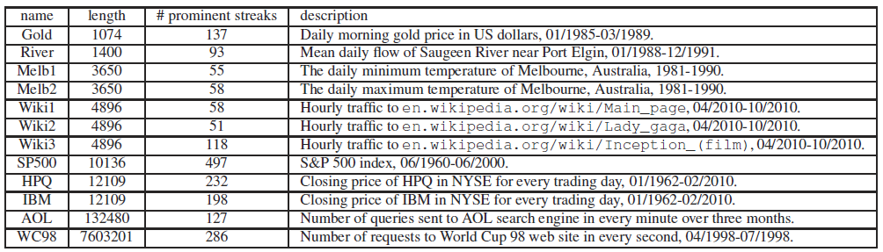
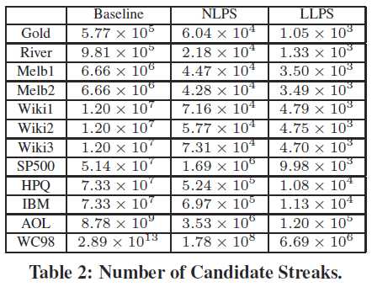
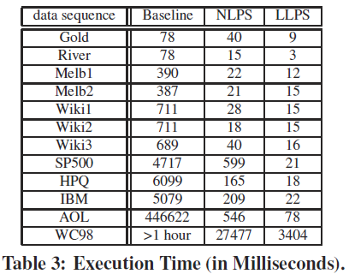
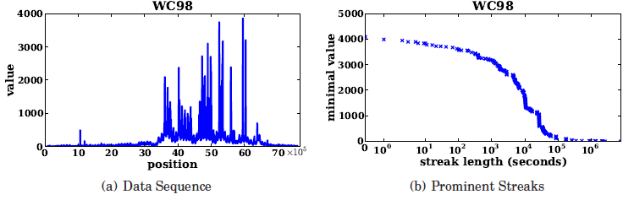
Datasets In Experiments
©2015 The University of Texas at Arlington. All Rights Reserved.

Slide 98


Sample Prominent Streaks
Melbourne daily min/max temperature between 1981 and 1990 (Melb1 & Melb2)
More than 2000 days with min temperature above zero
6 days: the longest streak above 35 degrees Celsius
Traffic count of Wikipedia page of Lady Gaga (Wiki2)
More than half of the prominent streaks are around Sep. 12th (VMA 2010)
at least 2000 hourly visits lasting for almost 4 days
©2015 The University of Texas at Arlington. All Rights Reserved.

Slide 99
General Prominent Streaks
Top-k, multi-dimensional and multi-sequence PS
“He (LeBron James) scored 35 or more points in nine consecutive games and joined Michael Jordan and Kobe Bryant as the only players since 1970 to accomplish the feat.”
“Only player in NBA history to average at least 20 points, 10 rebounds and 5 assists
per game for 6 consecutive seasons.” (http://en.wikipedia.org/wiki/Kevin Garnett)
NLPS/LLPS extended to such general PSs
©2015 The University of Texas at Arlington. All Rights Reserved.

Slide 100
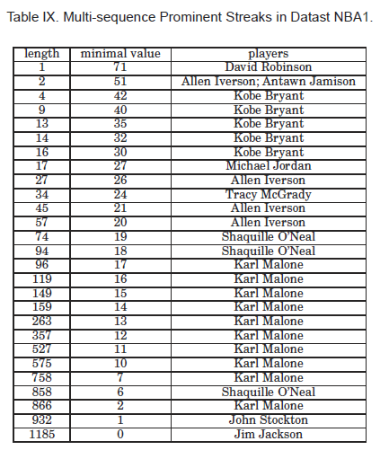
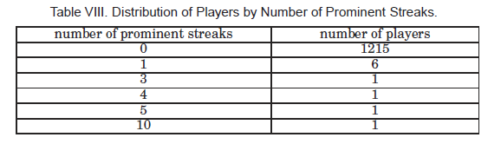
Experiments On Multi-Sequence PSs
©2015 The University of Texas at Arlington. All Rights Reserved.

Slide 101
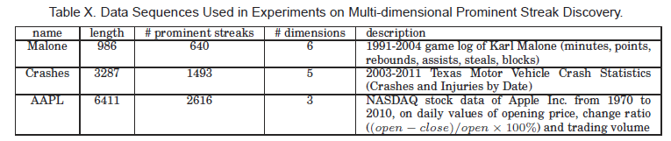
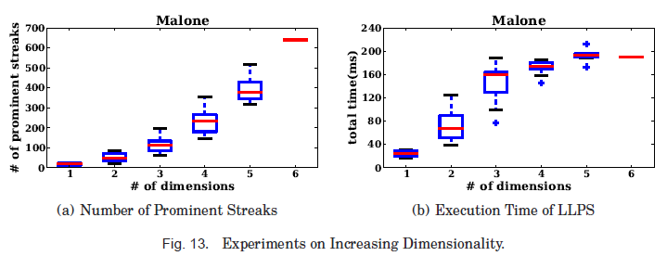
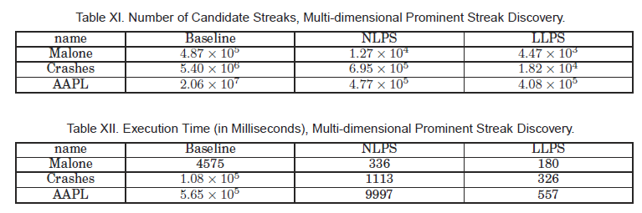
Experiments On Multi-Dim PSs
©2015 The University of Texas at Arlington. All Rights Reserved.

Slide 102
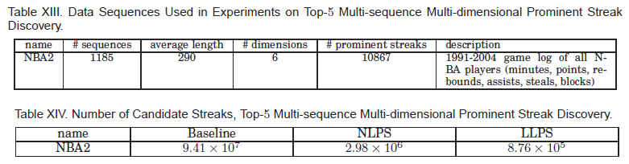
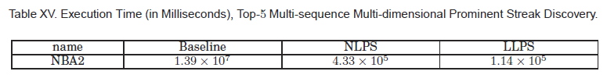
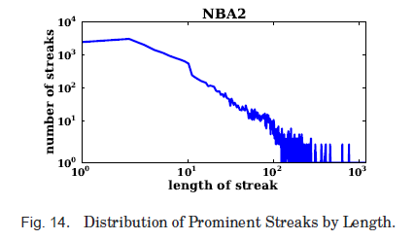
Experiments On General PSs
©2015 The University of Texas at Arlington. All Rights Reserved.

Slide 103
On "One of the Few" Objects. You Wu, Pankaj K. Agarwal, Chengkai Li, Jun Yang, Cong Yu. KDD 2012, pages 1487-1495.
©2015 The University of Texas at Arlington. All Rights Reserved.

Slide 104
One-Of-The-Few Claims
Do these claims really hold water?
Karl Malone is ONE OF THE ONLY TWO players in NBA history with 25,000 points, 12,000 rebounds, and 5,000 assists in one’s career.
He is ONE OF THE ONLY THREE candidates who have raised more than 25% from PAC contributions and 25% from self-financing.
How do we find truly interesting claims or individuals?
©2015 The University of Texas at Arlington. All Rights Reserved.

Slide 105
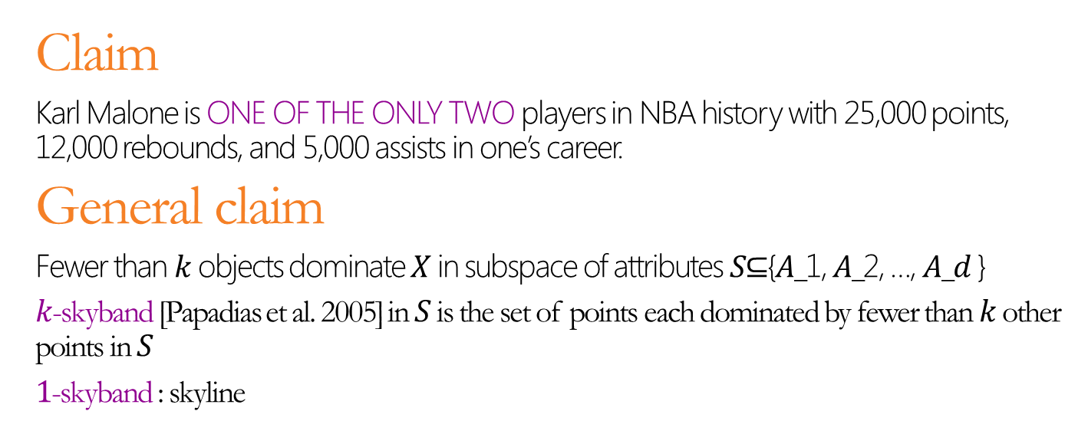
X Is One-Of-K →X Is In K-Skyband
Claim
Karl Malone is ONE OF THE ONLY TWO players in NBA history with 25,000 points, 12,000 rebounds, and 5,000 assists in one’s career.
General claim
Fewer than 𝑘 objects dominate 𝑋 in subspace of attributes 𝑆⊆{𝐴_1, 𝐴_2, …, 𝐴_𝑑 }
$k$-skyband [Papadias et al. 2005] in 𝑆 is the set of points each dominated by fewer than $k$ other points in 𝑆
1-skyband : skyline
1-skyband
2-skyband
©2015 The University of Texas at Arlington. All Rights Reserved.

Slide 106
Small K ≠Interesting
Subspaces are different
E.g., 2-skyand in {rebounds} vs. in {rebounds, assists}
Stockton
Stockton
Robertson
Robertson
James
Bird
James
Bird
Jordan
Baylor
Chamberlain
Jordan
Baylor
Chamberlain
Abdul-Jabbar
Pettit
Abdul-Jabbar
Pettit
©2015 The University of Texas at Arlington. All Rights Reserved.

Slide 107
Small K ≠Interesting
Data distribution matters
E.g., 2-skyand in {points, rebounds} vs. in {rebounds, assists}
Chamberlain
Stockton
Pettit
Robertson
Baylor
James
Bird
Abdul-Jabbar
Jordan
Chamberlain
Bird
Baylor
Johnson
James
Robertson
Jordan
Abdul-Jabbar
Pettit
Stockton
©2015 The University of Texas at Arlington. All Rights Reserved.

Slide 108
Top-τ Skyband
𝑘-Skyband
Using the same 𝑘 for all subspaces doesn’t work
Asking user pick 𝑘 for each subspace is infeasible
Top-τ Skyband
User specifies a single parameter τ to cap # skyband objects.
For each subspace 𝑆, find its top-𝜏 skyband, i.e., the largest 𝑘-skyband containing no more than 𝜏 objects
E.g., in {points, rebounds}:
𝜏=𝟐→ 1-skyband (size 2)
𝜏=𝟔→ 2-skyband (size 5; 3-skyband would be too big)
©2015 The University of Texas at Arlington. All Rights Reserved.

Slide 109
Experiments
©2015 The University of Texas at Arlington. All Rights Reserved.

Slide 110
Experiments
©2015 The University of Texas at Arlington. All Rights Reserved.

Slide 111
Experiments
©2015 The University of Texas at Arlington. All Rights Reserved.

Slide 112
Acknowledgment
UTA Students
Naeemul Hassan
Afroza Sultana
Gensheng Zhang
Collaborators
Pankaj Agarwal (Duke)
Ping Luo (Chinese Academy of Sciences)
Min Wang (Google Research)
Jun Yang (Duke)
Cong Yu (Google Research)
©2015 The University of Texas at Arlington. All Rights Reserved.

Slide 113




Acknowledgment
Funding sponsors
Disclaimer: This material is based upon work partially supported by the National Science Foundation Grants 1018865, 1117369 and 1408928, 2011 and 2012 HP Labs Innovation Research Awards, and the National Natural Science Foundation of China Grant 61370019. Any opinions, findings, and conclusions or recommendations expressed in this material are those of the author(s) and do not necessarily reflect the views of the funding agencies.
©2015 The University of Texas at Arlington. All Rights Reserved.

Slide 114
Thank You! Questions?
http://ranger.uta.edu/~cli
http://idir.uta.edu
cli@uta.edu
Demo
http://idir.uta.edu/factwatcher
©2015 The University of Texas at Arlington. All Rights Reserved.

